Slide 1
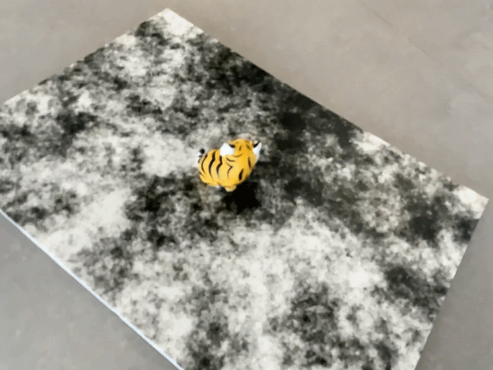
Zero-Shot Object Pose Estimation
Final Presentation
Mixed Reality Class 2022
A.Burzio, R. Pellerito, L. Piglia, D. Machain

Slide 2
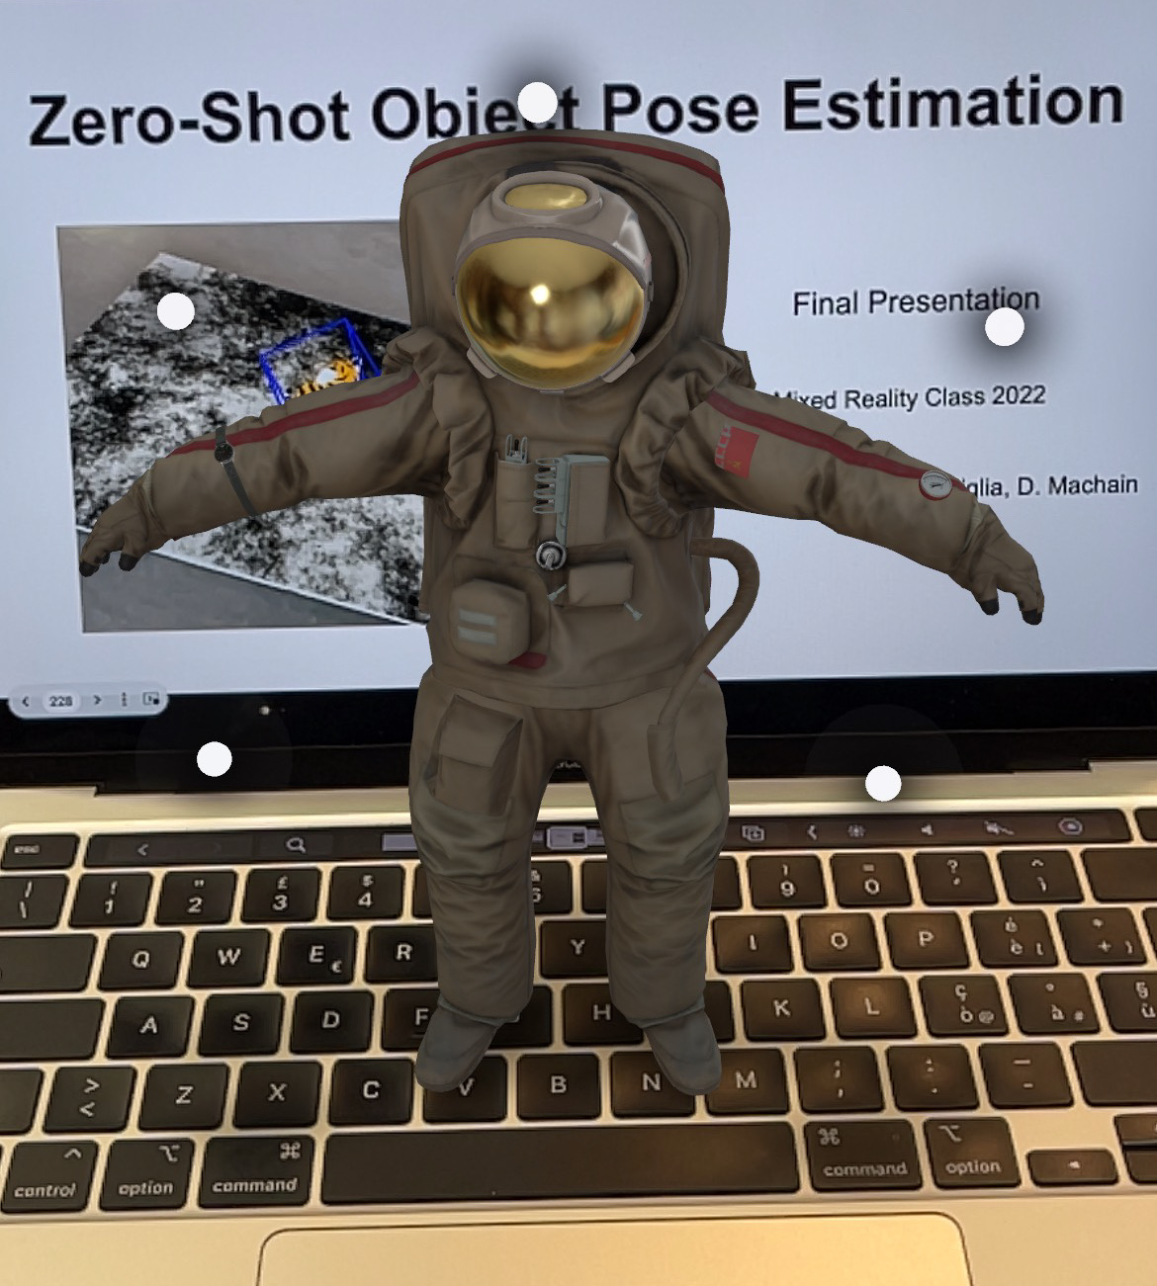
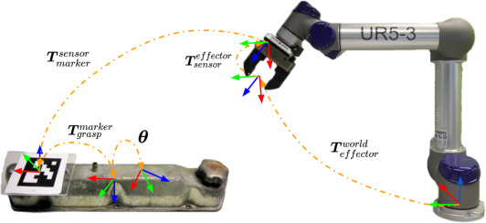
Motivations
Different application requires in-wild object pose estimation: AR, Robotics, Constructions
Track any object without categories or CAD models
Interaction between real and virtual objects

Slide 3
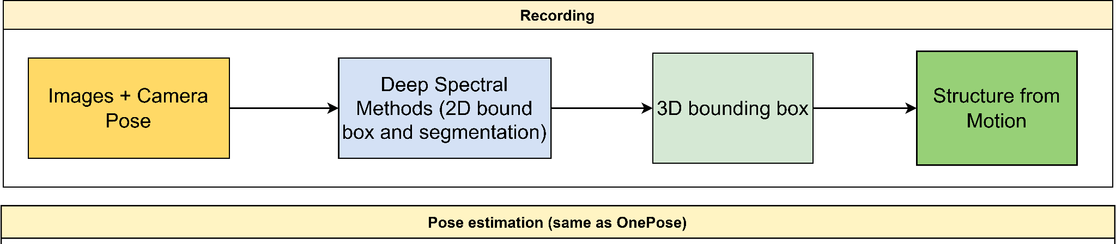
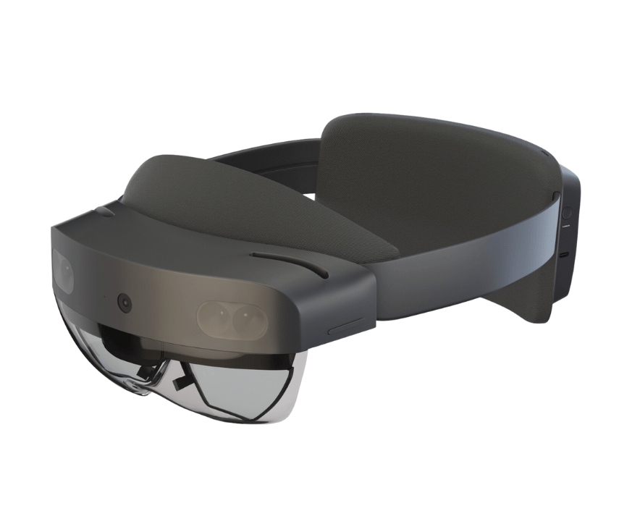



Architecture
Correspondence graphs
2D - 3D matching with DSM bbox for cropping image
Pose Estimation from PnP
Heavy processing
Images + camera poses
Unity application
Bounding Box info + object relative pose

Slide 4
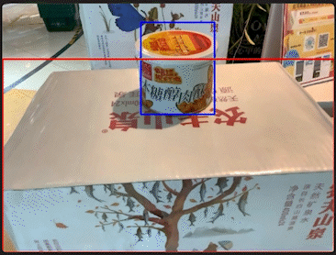
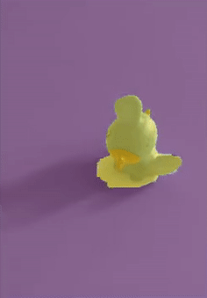
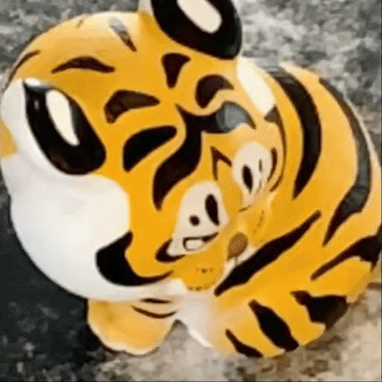
Deep Spectral Methods
Implementation
Used deep-spectral method (DSM) to make category-agnostic object detection (2D-BBox) from segmentation
Filtered segmentations with gaussian fitting
Use 2D detection to get keypoints only on the object for both SfM and inference

Slide 5
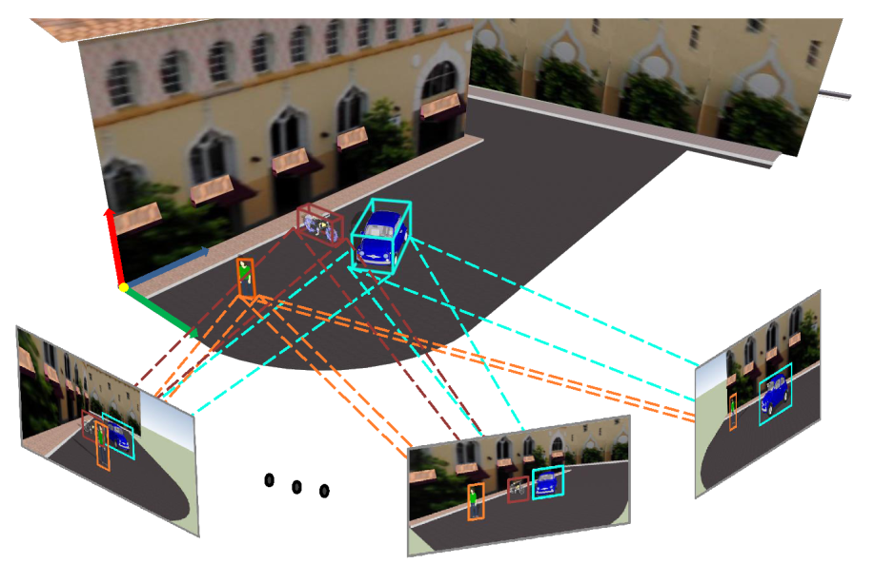
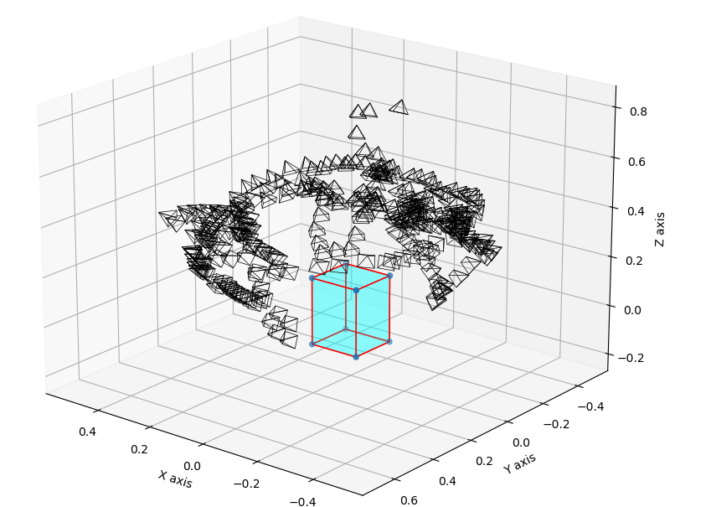
3D bounding boxes estimation
Implementation:
2D-BBoxes from DSM build 3D-BBoxes from many views

Slide 6
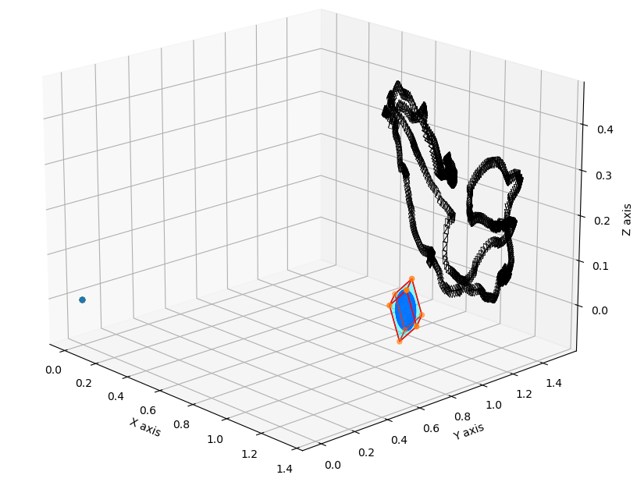
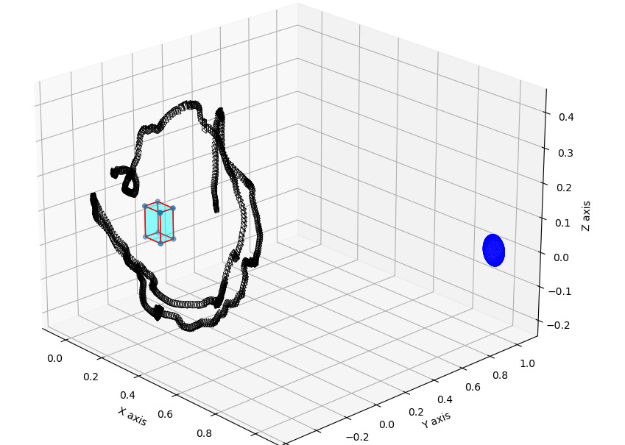
3D bounding boxes estimation
Implementation:
Poses are also transformed such that the object is in the origin of the coordinate frame - important for inference step

Slide 7
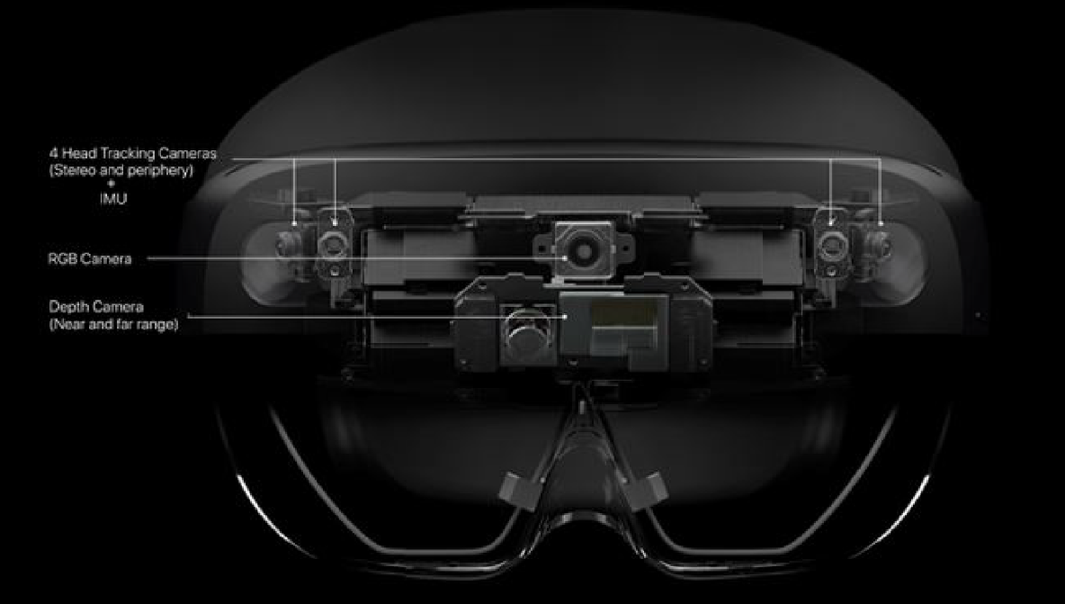
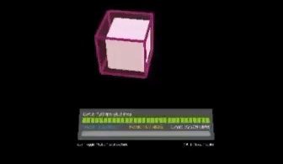
HoloLens - Server communication
Frames + camera pose in real time from HoloLens to the server using Unity-Robotics-Hub
Image processing run server-side
Display bounding boxes around objects on the Hololens app
  positions of the bounding boxes to be built from the server to the HoloLens

Slide 8
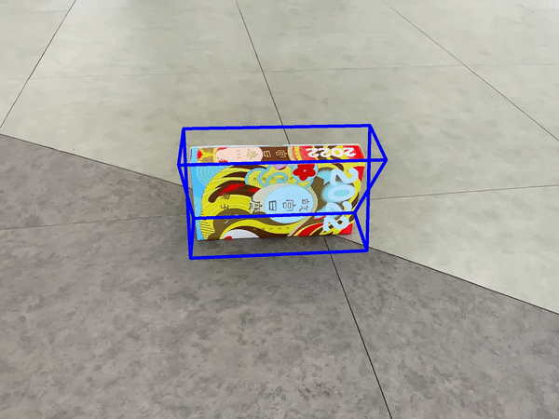
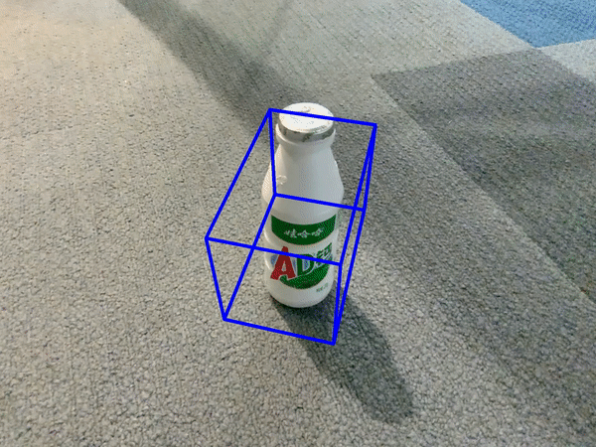
Zero-Shot Pose in action

Slide 9
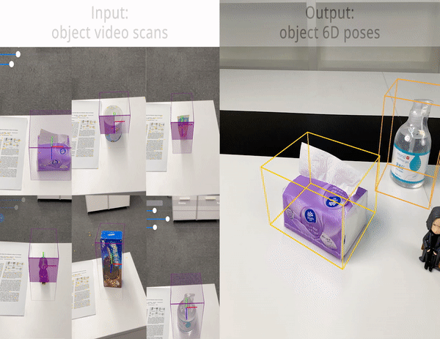
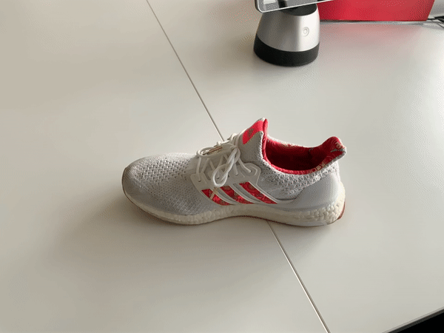
Comparing assumptions: Zero-Shot Pose vs One Pose
OnePose:
Images + poses
Perfect object detection
Hand-Drawn 3D bounding box
Zero-Shot Pose
Images + poses only!

Slide 10
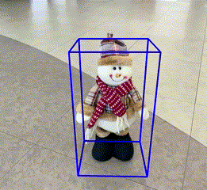
Next steps and considerations
Get 3D reconstruction with HoloLens data working
Constrain 3D bounding box to be aligned with ground when scanning
Track keypoints and filter predictions between frames
Improve framerate of pose and image stream from Hololens (currently 4 fps)
Object scanning with a head-mounted device is uncomfortable
Bounding box is good, but jitters

